Slide 1

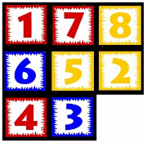
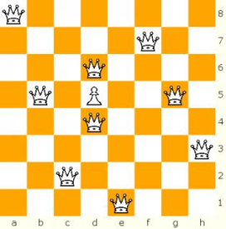
Chapter 3: Informed Search and Exploration
Dr. Daisy Tang

Slide 2
Informed Search
Definition:
Use problem-specific knowledge beyond the definition of the problem itself
Can find solutions more efficiently
Best-first search
Greedy best-first search
A*
Heuristics

Slide 3
Best-First Search
Idea: use an evaluation function f(n) for each node
estimate of "desirability"
Expand most desirable unexpanded node
Implementation: use a data structure that maintains the frontier in a decreasing order of desirability
Is it really the best?
Special cases: uniform-cost (Dijkstra’s algorithm), greedy search, A* search
A key component is a heuristic function h(n):
h(n) = estimated cost of the cheapest path from node n to a goal node
h(n) = 0 if n is the goal
h(n) could be general or problem-specific

Slide 4
Best First Search Algorithm
initialize the Q with the starting state (node)
while Q is not empty, do
assign the first element of Q to N
if N is the goal, return SUCCESS
remove N from Q
add the children of N to Q
sort the entire Q by f (n)
return FAILURE

Slide 5
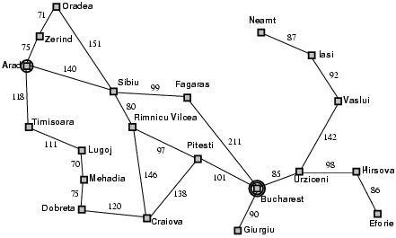
Recall Romania Map Example
What’s a proper heuristic that measures cheapest path from current node to goal node?

Slide 6
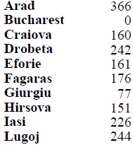
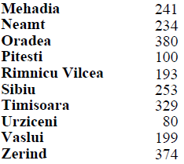
Romania Map with Costs

Slide 7
Greedy Best-First Search
Evaluation function: f(n) = h(n)
estimate the cost from n to goal
h_{SLD} = straight line distance from n to Bucharest

Slide 8

Example: Arad to Bucharest

Slide 9
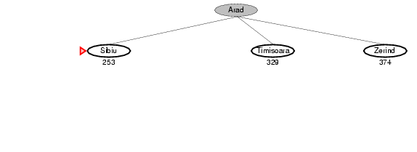
Example: Arad to Bucharest

Slide 10
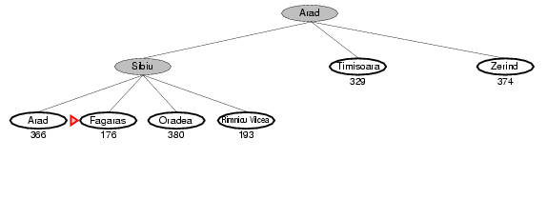
Example: Arad to Bucharest

Slide 11
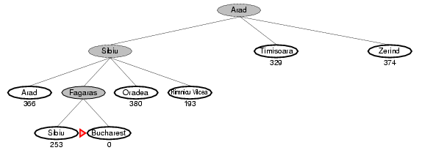
Example: Arad to Bucharest

Slide 12
Analysis of Greedy Best-First
Complete?
From Iasi to Fagaras
No – can get stuck in loops, e.g., Iasi → Neamt → Iasi → Neamt → …
Time?
O(b^{m}), but a good heuristic can give dramatic improvement
Space?
O(b^{m}) -- keeps all nodes in memory
Optimal?
No

Slide 13
In-Class Exercise #3.8
Draw the search tree generated by Greedy search implemented with tree-search algorithm to find a path from T (Timisoara) to B (Bucharest)

Slide 14
A*: Minimizing Total Est. Cost
Idea: avoid expanding paths that are already expensive
Evaluation function f (n) = g(n) + h(n)
g (n) = cost so far to reach n
h (n) = estimated cost from n to goal
f (n) = estimated total cost of path through n to goal

Slide 15

A* Search Example

Slide 16
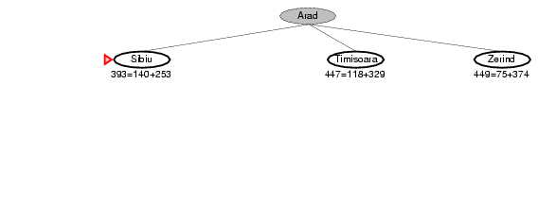
A* Search Example

Slide 17
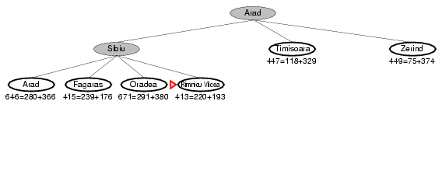
A* Search Example

Slide 18
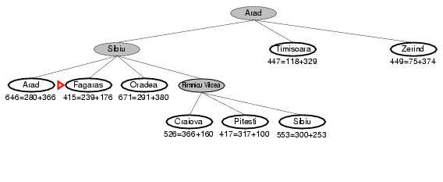
A* Search Example

Slide 19
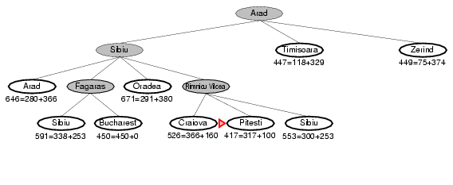
A* Search Example

Slide 20
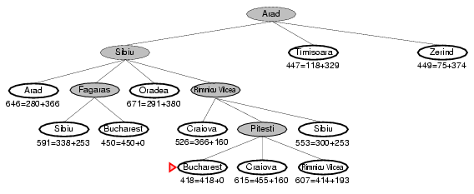
A* Search Example

Slide 21
In-Class Exercise #3.9
Draw the search tree generated by applying A* and graph-search to find a path from Lugoj to Bucharest using the straight-line distance heuristic. Show the f-cost f(n) for each node.

Slide 22
Admissible Heuristic
A heuristic h(n) is admissible if for every node n, h(n) ≤ h*(n), where h*(n) is the true cost to reach the goal state from n
An admissible heuristic never overestimates the cost to reach the goal, i.e., it is optimistic
Example: h_{SLD}(n) (never overestimates the actual road distance)
Theorem: If h(n) is admissible, A* using TREE-SEARCH is optimal

Slide 23
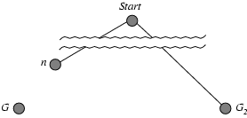
Optimality of A* -- Proof
Suppose some suboptimal goal G₂ has been generated and is in the frontier. Let n be an unexpanded node in the frontier such that n is on a shortest path to an optimal goal G.
Assume the optimal cost is C*
f(G₂) = g(G₂) + h(G₂) = g(G₂) > C*
f(n) = g(n) + h(n) <= C*
from the above, we have
f(n) <= C* < f(G₂)
thus G₂ will not be expanded

Slide 25
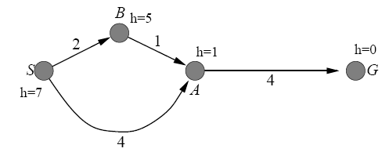
Case-Study
A* using Graph-Search returns a suboptimal solution with an h(n) function that is admissible.

Slide 26
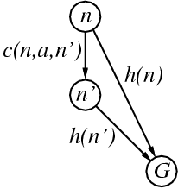
Consistency Heuristics
A heuristic is consistent if for every node n, every successor n' of n generated by any action a, h(n) ≤ c(n,a,n') + h(n')
Triangle inequality
Every consistent heuristic is also admissible
Proof by induction on the number k of nodes
on the shortest path to any goal from n.
K = 1, let n’ be the goal node; then h(n) ≤ c(n, a, n’)
Assume n’ is on the shortest path k steps from the goal and that h(n’) is admissible by hypothesis, then:
h(n) ≤ c(n,a,n’) + h(n’) ≤ c(n,a,n’) + h*(n’) = h*(n)
So, h(n) at k+1 steps from the goal is also admissible.

Slide 27
A* With Graph Search
Theorem: If h(n) is consistent, A* using GRAPH-SEARCH is optimal
If h is consistent, and n’ is a successor of n, we have
f(n') = g(n') + h(n')
= g(n) + c(n,a,n') + h(n')
≥ g(n) + h(n)
= f(n)
i.e., f(n) is non-decreasing along any path
Whenever A* selects a node for expansion, the optimal path to that node has been found

Slide 28
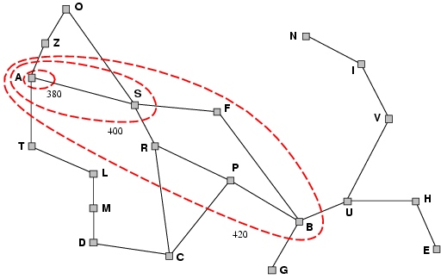
Optimality of A*
A* expands nodes in order of increasing f value
Assume C* is the optimal cost
A* expands all nodes with f(n) < C*
A* might then expand some of the nodes right on the “goal contour” (f(n) = C*) before selecting a goal node
Uniform-cost search (h(n) = 0) → bands more circular

Slide 29
Analysis of A*
Important idea:
appropriate h(n) function
A* is optimal efficient (no other optimal alg. is guaranteed to expand fewer nodes than A*)
pruning while still guaranteeing optimality
Complete?
Yes (unless there are infinitely many nodes with f ≤ f(G))
Optimal?
Yes, with finite b and positive path cost
However, A* is not the answer for all problems
Time?
Exponential in the length of the solution
Space?
Keeps all nodes in memory
A* usually runs out of space long before it runs out of time

Slide 30
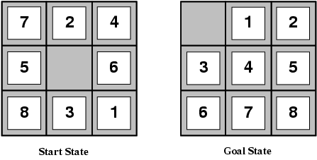
Heuristic Functions
Two commonly used functions:
h₁(n) = number of misplaced tiles
e.g., h₁(n) = 8 in the above example
h₂ (n) = sum of the distances of the tiles from their goal positions, called Manhattan distance
e.g., h₂ (n) = 3 + 1 + 2 + 2 + 2 + 3 + 3 + 2 = 18 in the above example

Slide 31
Quality of Heuristic
Assume # of nodes generated by A* for a problem is N and the solution depth is d, then b* is the effective branching factor that a uniform tree of depth d would have to have. Thus:
N + 1 = 1 + b* + (b*)² + … + (b*)^{d}
b* might vary across problem instances, but is fairly constant for sufficiently hard problems
A well-designed heuristic would have a value of b* close to 1

Slide 32
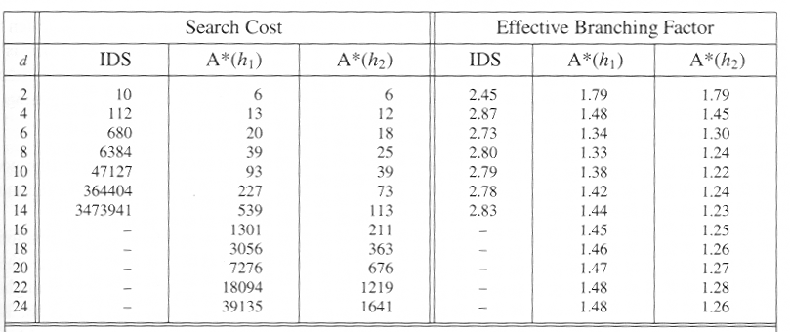
The Comparison
Each data point corresponds to 100 instances of the
8-puzzle problem in which the solution depth varies.

Slide 33
Heuristics Domination
If h₂(n) ≥ h₁(n) for all n (both admissible)
then h₂ dominates h₁
h₂ is better for search
A* using h₂ will never expand more nodes than A* using h₁

Slide 34
Inventing Admissible Heuristic
A problem with fewer restrictions on the actions is called a relaxed problem
The cost of an optimal solution to a relaxed problem is an admissible heuristic for the original problem
If the rules of the 8-puzzle are relaxed so that a tile can move anywhere, then h₁(n) gives the shortest solution
If the rules are relaxed so that a tile can move to any adjacent square, then h₂ (n) gives the shortest solution

Slide 35
Inventing Admissible Heuristic
If a collection of admissible heuristics h₁ … h_{m} is available, and none of them dominates any of the others, we can choose
h (n) = max{h₁(n), …, h_{m}(n)}
We can also get from sub-problem of a given problem

Slide 36
In-Class Exercise #3.10
The heuristic path algorithm is a best-first search in which the objective function is f(n) = (2-w) x g(n) + w x h(n). For what values of w is the algorithm guaranteed to be optimal? (You may assume that h is admissible.) What kind of search does this perform when w = 0? When w = 1? When w = 2?

Slide 37
In-Class Exercise #3.11
Prove each of the following statements:
Breadth-first search is a special case of uniform-cost search.
Breadth-first search, depth-first search, and uniform-cost search are special cases of best-first search.
Uniform-cost search is a special case of A* search.

Slide 38
Discussion
Project 1

Slide 39
Summary
Applying heuristics to reduce search costs
Best-first search: h(n)
Greedy best-first search: h(n)
A*: f(n) = g(n) + h(n)

